Slide 1
P2-Hnefatafl
-Party A
Members(A-Z):
Emmett BeAney, Jacinda Li ,Miriam Alzamily, Nana Yin, Shreya Uday

Slide 2
The perfection of documents
1. User stories
2.CRC card & class diagram
3.Acceptance Criteria
4. Task for User stories
5. Development Manual
Picture Source: the picture from the network. https://zhuanlan.zhihu.com/p/33300643

Slide 3
User Stories

Slide 4

User Stories
1. As a user, I want to register to this platform by using an email, nickname and a password.
2. As a user, I want to login to this platform using the account I registered.
3. As a user, I want to be able to play Hnefatafl.
4. As a user, I want to know when it is my turn.
5. As a user, I want to be able to logout from my account when I do not want to play, and receive a prompt before it exits.

Slide 5
Move methods
Gameboard
void initialize()
Piece getPiece()
boolean placePiece()
int move()
int getWhoseTurn()
int checkStatus()
Piece
String getColor()
String getPosition()
void setPosition()
ArrayList<String> legalMoves()

Slide 6
Task for User Stories
·As a user, I want to be able to play Hnefatafl. (Backend function finished)
Priority:1
Task:
1.Implement ability to display basic game screen to the user
2.Write code to achieve chess movement
3.Write code to achieve the pieces capturing the opponent’s pieces
4.Write code to update game screen
5.Write code to add the logout button

Slide 7
Task for User Stories
• As a user, I want to know when it is my turn. (Finished)
Priority:2
Task:
1.Write code to determine which users turn it is
2.Add functionality to display the prompt

Slide 8
Task for User Stories
• As a user, I want to register to this platform by using an email, nickname and a password. Priority:3 (Finished)
Task:
1.Write code about basic register screen
2.Write code to implement the legality of user information (such as the format of E-mail, length of password).
3.Write code to implement the registration button and the cancel button
4.Write code to achieve a successful registration screen and return to the login screen button

Slide 9
Task for User Stories
• As a user, I want to login to this platform using the account I registered. (Finished)
Priority:4
Task:
1.Write code to implement basic Login screen
2.Write code to implement the legality of user information (such as the format of E-mail, length of password).
3.Write code to implement the login button and the registration button
• As a user, I want to be able to logout from my account when I do not want to play, and receive a prompt before it exits. (Finished)
Priority:5
Task:
1.Write code to logout prompt screen
2.Write code to implement the logout button and the return button
3.Write code to jump back to the login screen

Slide 10
CRC Cards &
Class Diagram

Slide 11
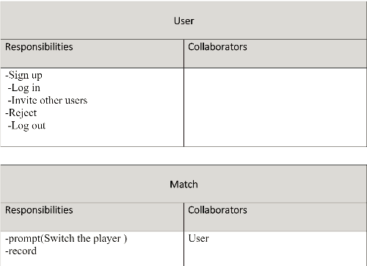
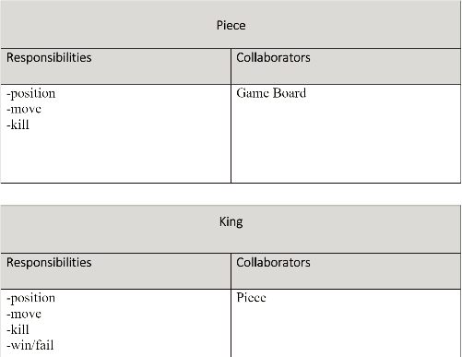
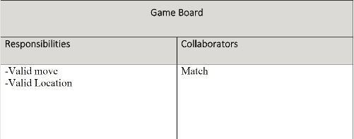
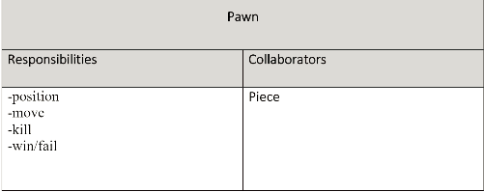
CRC Cards &Class Diagram

Slide 12
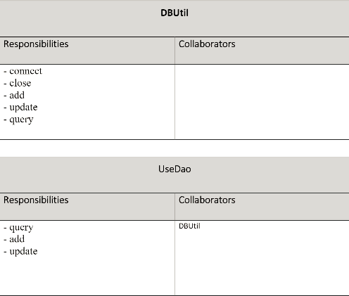
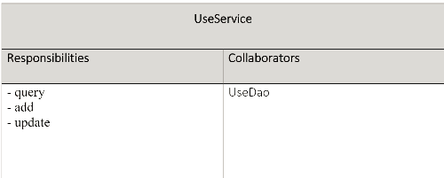
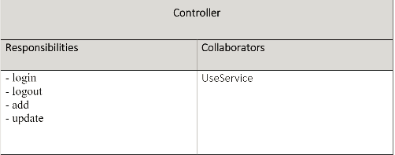
CRC Cards &Class Diagram

Slide 13
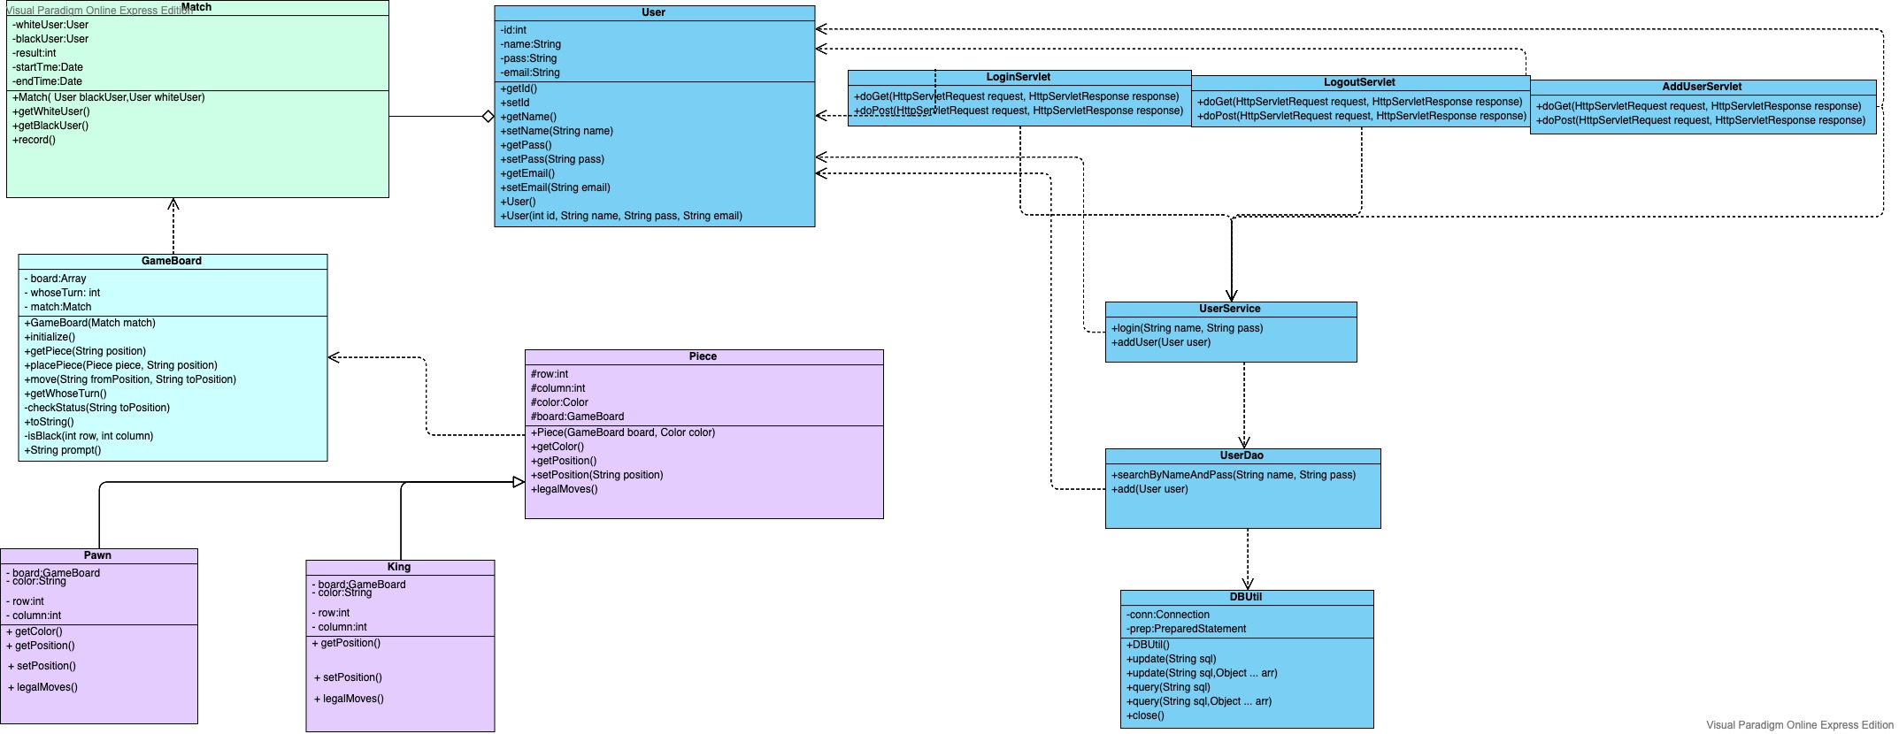
CRC Cards &Class Diagram

Slide 14
Kanban &
Traceability link
matrix

Slide 15
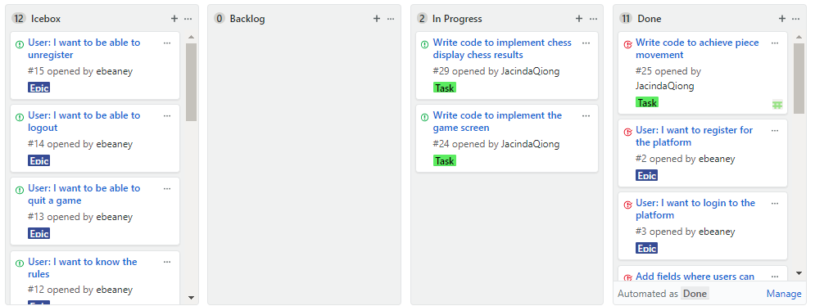
Kanban

Slide 16
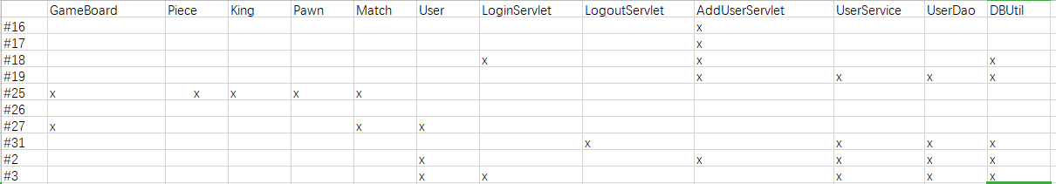
Traceability link matrix

Slide 17
Sprint Review
and Retrospective

Slide 18
Sprint Review and Retrospective
Daily scrums:
Discussed progress
Review:
Went over results of sprint
Made changes as needed according to product owner
Retrospective:
Identified what could improve
Identified what went well

Slide 19
Sprint Review and Retrospective
10/11-During this scrum, we discussed the file content of P2 together and allocated the files within the file.
10/21-During this scrum, we asked the professor about the parts of the P1 document that could be improved. The task of file improvement was assigned.
10/24-During this scrum, we solved the game's implementation of the code logic for the round, assigned code tasks based on the improved task and each person's familiar direction, and worked out the deadline.
10/31-During this scrum, we integrated the code into a project.

Slide 20
Sprint Review and Retrospective
What went well:
Our scrum meetings discussed a lot of details about the implementation of the game, actively assigning tasks, making plans for each week and the next meeting time.
What could improve:
1.The task should smaller and clearer, avoiding two people spending time on similar functionality
2. Need more effective communication during our team meeting
3. Everyone must abide by agreed upon deadlines and deliver the outcomes on time.
4. Have more meetings with the PO

Slide 21
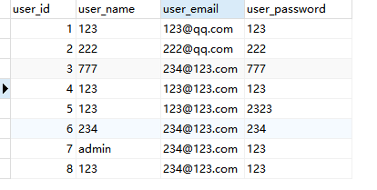

MySQL

Slide 22
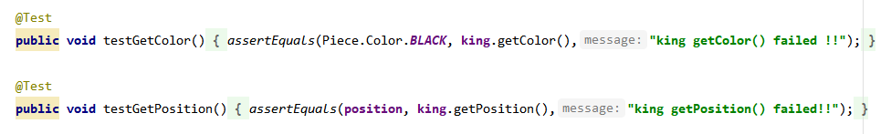
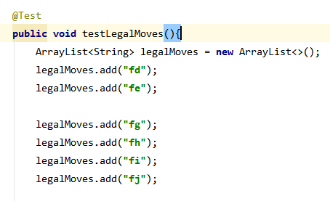
Junit 5

Slide 23
DEMO

